Slide 1
Programming project
Victoria Hill

Slide 2
The challenge set
Design code and test a maze game in which a character is guided through a simple maze by the
player pressing keys for left, right, up and down movements.

Slide 3
The subTasks
The character should face in the direction of travel and should not be able to move outside the playing area, bouncing back if it touches the edge.
If the character touches the walls of the maze then it should return to a predetermined start position.
If the character is guided successfully around the maze to the finishing point then a message or other indication of success should be displayed.
The character must be able to move with the up, down, left and right keys.

Slide 4
My analysis
I felt that the making of the game went very well, although after the master class I did not get chance to do as much as I would like to have, I felt I achieved real progress at the master class. By the use of planning, in the form of flow charts and the use of logic we managed to figure out and execute the challenge given to us, and in this PowerPoint I will demonstrate how we did so.

Slide 5
Movement of the character
Basic Movement-
The first thing that we began to do was to make sure that our character was able to move with the up, down, left and right keys.
This was the first thing we decided to do as it is the basis of every game that the character should be able to move by pressing the up down and left and right keys.
This involved a very easy simple program and the flowchart in the next slide shows how this program was done and developed from.

Slide 6


The FloWCHART
START
If left key selected
Y
N
Character move left
Else if down key selected
Else if up key selected
N
Else if right key selected
Y
N
Y
Move character down
Y
Character move right
Move character up
END

Slide 7
The code
keystates = SDL_GetKeyState( NULL );
if(keystates[SDLK_LEFT]){
character=left;
x-=moveSpeed;
}else if(keystates[SDLK_RIGHT]){
character=right;
x+=moveSpeed;
}
if(keystates[SDLK_UP]){
y-=moveSpeed;
character=up;
if(keystates[SDLK_LEFT])
{
character=upLeft;
}
if(keystates[SDLK_RIGHT])
{
character=upRight;
}
}
else if(keystates[SDLK_DOWN]){
y+=moveSpeed;
character=down;
if(keystates[SDLK_LEFT])
{
character=downLeft;
}
if(keystates[SDLK_RIGHT])
{
character=downRight;
}
}
This is the code that instructs the computer what to do when any of the keys specified are selected and then moves the character in that direction.

Slide 8
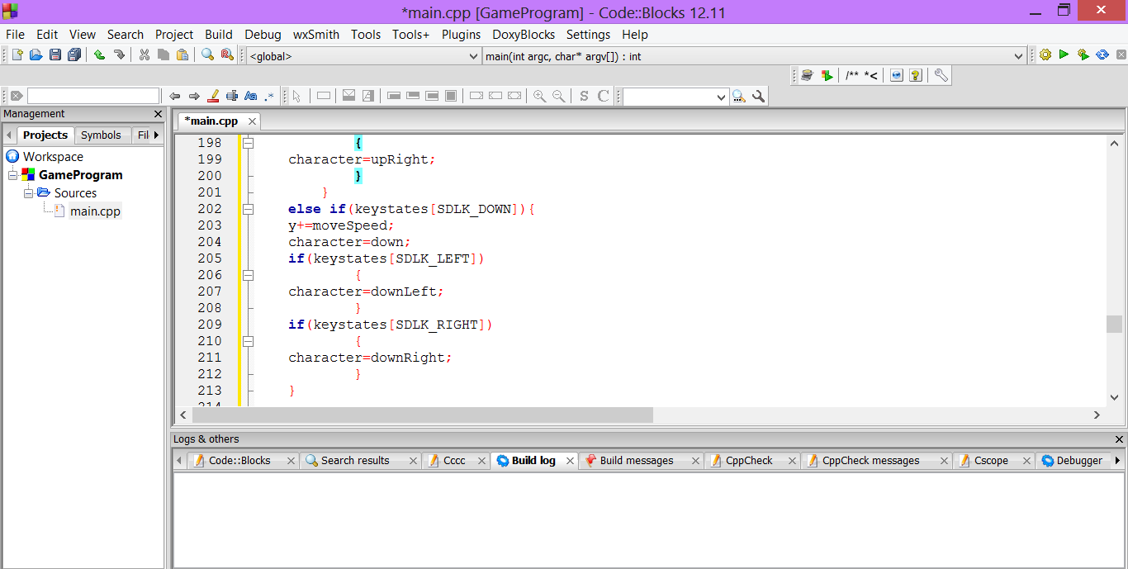
In the master class we first had trouble but now when I test the piece of code there are no problems with the code and it means that the game would all work fine and the character would move according to the key pressed.
NO PROBLEMS!

Slide 9
MOVEMENT OF THE CHARACTER
Rotation of the Character
The second part of the movement of the character that we had to do was rotating the character to face the direction in which it travelled.
This again involved logical thinking and trying to not over complicate the program/code. This thinking again will be shown in a flowchart in the next slide. In order to do this, the code would need to include the image of the character that we were using so that the right thing would be rotated when necessary.
This was one of the harder things to do but eventually we had our working code.

Slide 10
The code
This code shows how when a character travels in a certain direction it will show up as rotated.
up = CCSS_load_resize_and_rotate("./resources/img/smiley.png", 0.05, 180);
upLeft = CCSS_load_resize_and_rotate("./resources/img/smiley.png", 0.05, 225);
left = CCSS_load_resize_and_rotate("./resources/img/smiley.png", 0.05, 270);
downLeft = CCSS_load_resize_and_rotate("./resources/img/smiley.png", 0.05, 315);
down = CCSS_load_resize_and_rotate("./resources/img/smiley.png", 0.05, 0);
downRight = CCSS_load_resize_and_rotate("./resources/img/smiley.png", 0.05, 45);
right = CCSS_load_resize_and_rotate("./resources/img/smiley.png", 0.05, 90);
upRight = CCSS_load_resize_and_rotate("./resources/img/smiley.png", 0.05, 135);

Slide 11
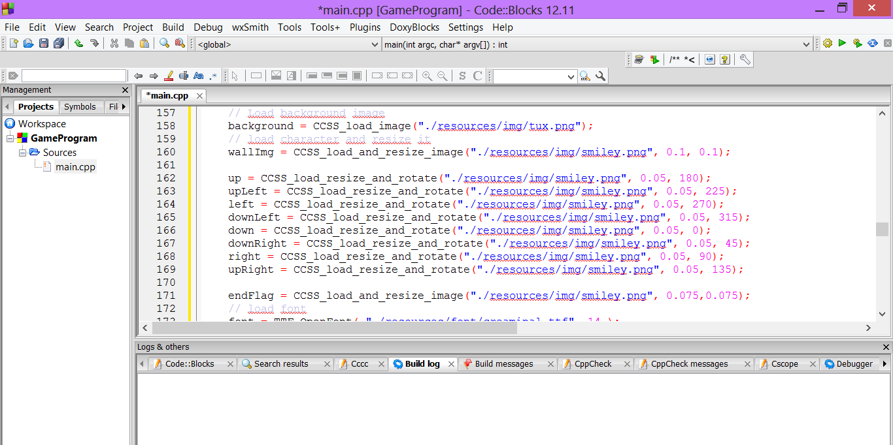
Again with this part of the movement we had no problem, and the character began to move as normal but rotated to face the direction it travelled.
SUCCESS!

Slide 12
The walls
After using the code that we were already supplied with, we had the basis of the game. The first subtask that we began to develop was inserting the walls, after drawing out our plan of the walls and where we planned to put the walls we began finding the right co-ordinates.
As we found all the co-ordinates we needed we then began to write the program for the walls, this program was done firstly by making a flowchart and then writing it out in code from there.

Slide 14
The code
walls[0].x=60;
walls[0].y=0;
walls[1].x=120;
walls[1].y=0;
walls[2].x=120;
walls[2].y=60;
walls[3].x=240;
walls[3].y=60;
walls[4].x=60;
walls[4].y=120;
walls[5].x=240;
walls[5].y=180;
walls[6].x=300;
walls[6].y=180;
walls[7].x=60;
walls[7].y=240;
walls[8].x=120;
walls[8].y=240;
walls[9].x=300;
walls[9].y=240;
*/
This is the code we used to display the walls on the game background. We then went on to test this code in the form of unit testing.

Slide 15
The Code
collision_box;
collision_box *setUpWalls( void )
int collide(collision_box box1,collision_box box2){
This is the piece of code that enabled the character to go back to the start automatically if they hit the walls.

Slide 16
The flowchart
START
If character touches collision box
Y
N
Collision box flow chart.
Return to start
Continue game

Slide 17
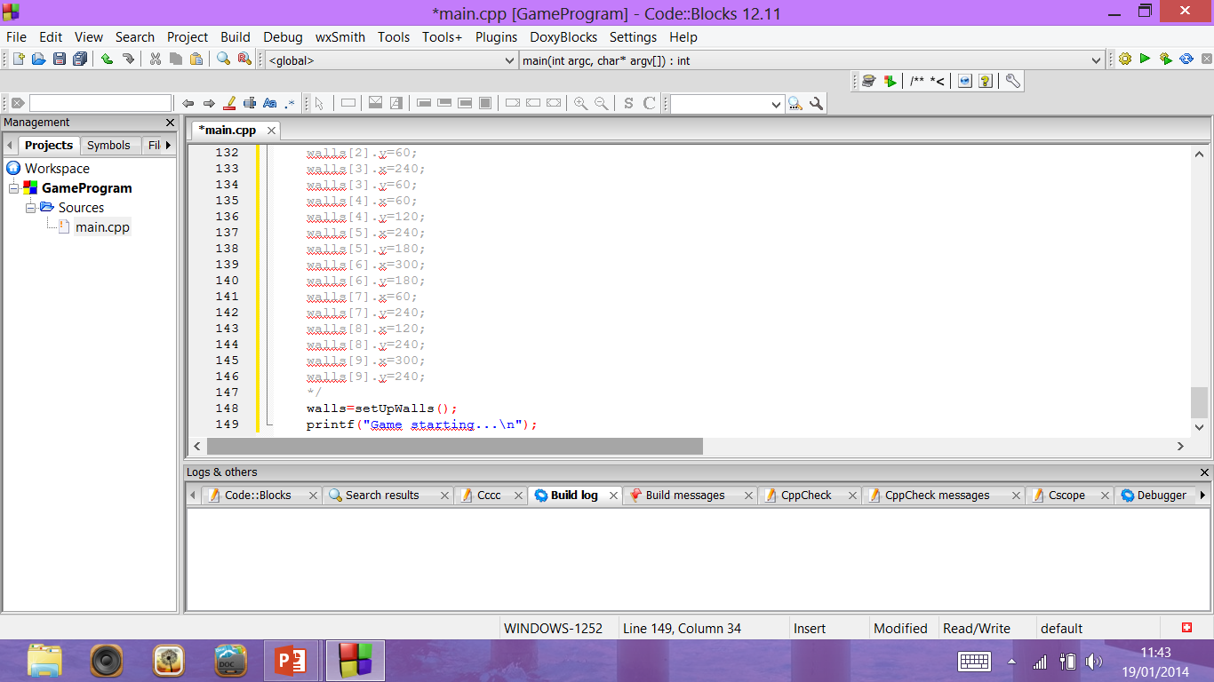
After building and running the program, there were no problems shown.
We had now completed one of the subtasks.

Slide 18
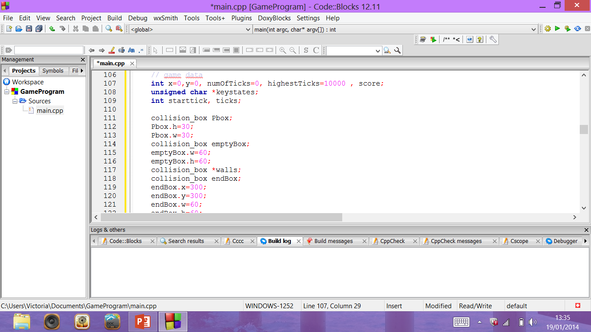
After testing the collision boxes we found that they also worked successfully, which meant that I game began to progress very well now.

Slide 19
Winning the game
The next subtask we hade to complete was if the character is guided successfully around the maze to the finishing point then a message or other indication of success should be displayed.
Again once we had thought about how to do this logically we began to write the code. The logical thinking involved making another flow chart as this helps to show how we would go about writing the code.

Slide 20
The code,
if (collide(Pbox, endBox)==1){ CCSS_apply_surface(0, 0, background, screen); CCSS_print(100, 0, font, text_color, screen, "YOU WIN!!!"); score=highestTicks-numOfTicks; CCSS_print(100,50, font, text_color, screen, "Score: %d", score);
won=TRUE; quit=TRUE; } numOfTicks+=9; } if(won==TRUE){ SDL_Flip( screen ); SDL_Delay(3000); } printf("Closing the game...\n"); // Free background SDL_FreeSurface( background ); SDL_FreeSurface( character ); // unload font TTF_CloseFont(font); // Quite SDL SDL_Quit();
This is the code that shows if the person has won the game or selected to exit the game that the game is able to close and a message will be printed if they win.

Slide 21
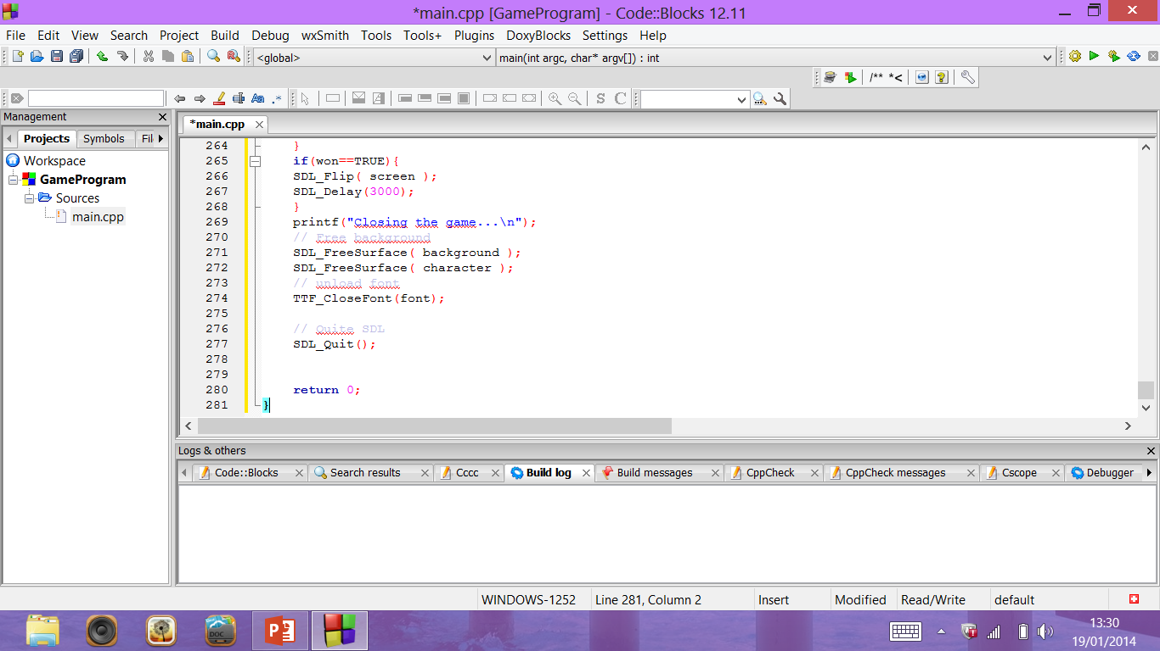
AF
After building and running the code to show the message that the person had one, we found that it also showed up with no problems.

Slide 22
This is what it looks like when you win the game.

Slide 23
The flowchart
Start
Character moves
If character hits wall
Return to start
Continue
If player finishes game
Y
N
Display message and scoreboard.
Return to Start
End

Slide 24
The testing of the code

Slide 25
Subtask (Code) | Method of Testing | Did it work? | Adjustments needed
Movement of the character~ if(keystates[SDLK_RIGHT]) { character=upRight; } | Unit Testing | Not to begin with, we had to make alterations as our loops did not work to begin with. But after adjustments when the code is tested now it will work. | We needed to adjust where the loops began and ended as to begin with we had not organised the code well, but after alterations the character moved according to the keys pressed.
Rotation of the Character~ up = CCSS_load_resize_and_rotate("./resources/img/smiley.png", 0.05, 180); | Unit Testing | Yes, the character now rotates to face the direction in which it travels automatically. | No adjustments were needed.

Slide 26
Subtask (Code) | Method of Testing | Did it work? | Adjustments needed
WALLS~ Example of code walls[0].x=60; walls[0].y=0; | Unit Testing | Yes, and all the walls are in the right place after adjusting. | Some of the wall co-ordinates needed adjusting but all the code worked.
Collision Boxes~ collision_box; collision_box *setUpWalls( void ) | Unit Testing | Yes, the character moved back to the start if it touches any of the walls. | Before tested we saw some wrong positioning of the brackets but quickly adjusted them.
End of game code~ if (collide(Pbox, endBox)==1){ CCSS_apply_surface(0, 0, background, screen); | Unit Testing | Yes, message appeared when the character reached the end of the game. And then ended the game. | Mistakes were noticed before we tested it in the master class but only minor ones such as spelling mistakes.

Slide 27
Why we used unit testing..
We decided to use unit testing for each subtask as it made it easier to identify any mistakes in the program if there was any.
The accuracy of the program was better using unit testing as it was easier for the computer to find any problems with the code if there were any, and then finding this problem was easier for us as we did not have to scroll through pages and pages of code to find one mistake.
Unit Testing not only made the code more accurate but it also saved us lots of time when first developing the program.
Instead of using a test in which we tested the whole problem we used unit testing as it was the best solution to the problems ibn our code.

Slide 28
The subTasks
The character should face in the direction of travel and should not be able to move outside the playing area, bouncing back if it touches the edge.
If the character touches the walls of the maze then it should return to a predetermined start position.
If the character is guided successfully around the maze to the finishing point then a message or other indication of success should be displayed.
The character must be able to move with the up, down, left and right keys.

Slide 29
All done!
In the end we managed to have our fully functioning game and we successfully completed all the subtasks. As we already had some information supplied such as the background and character, we decided to keep these and not change them:
// Load background image
background = CCSS_load_image("./resources/img/tux.png");
// load character and resize it
wallImg = CCSS_load_and_resize_image("./resources/img/smiley.png", 0.1, 0.1);

Slide 30
All done!
In order for us to have succeeded using the use of unit testing was vital. As this made it made testing the program and then identifying and finding any problems much easier. Testing in smaller parts also helped us to realise how we could improve the overall look of the game also.
Overall, the testing, organisation and final look of game was very
good. Although we had to make a few adjustments along the way we finally had our completed and fully functioning game which hd all the subtasks set part of it and working.

Slide 31

WHAT WE ACHIEVED:
Success criteria's were met.
The game works.
It has excellent presentation.
All subtasks are included and work.
The game is compatible with many different computers also.
The game has scoring.
It can also be won easily.

Slide 32
The game was a success!

